Slide 1
ALPSTAR
Alpweek - Poschiavo
Session 12: Alpstar

Slide 2
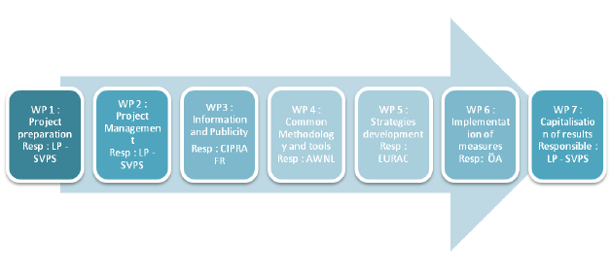
Workpackages

Slide 3
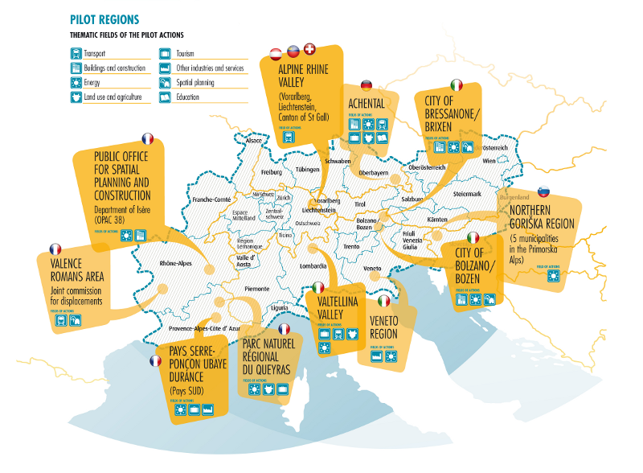
Pilot regions - thematic working fields

Slide 4
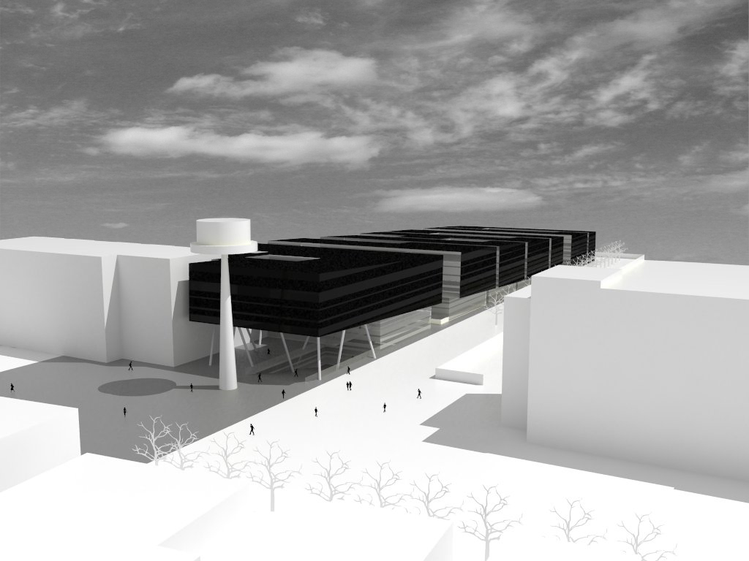
Bolzano: Realization of a Net Zero Energy Building
Realization of a new office building as Net Zero Energy Building
Refurbishment of two existing buildings
Overall investment ~ 60 Mill.
Construction: 2012 - 2014

Slide 5
Bolzano: New City Quarter CasaNova
Probably the most energy efficient new city quarter in Italy
Construction mostly terminated and people already living in

Slide 6
ALPSTAR CIPRA Fr - Pilot Regions 1: PNRQ 2: Pays SUD
Alpweek - Poschiavo
Session 12: Alpstar

Slide 7
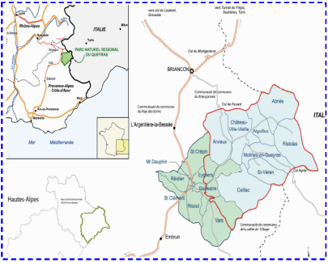
PNRQ
8 Communities, 1300m < villages altitude < 2000m, 2 500 hab.

Slide 8
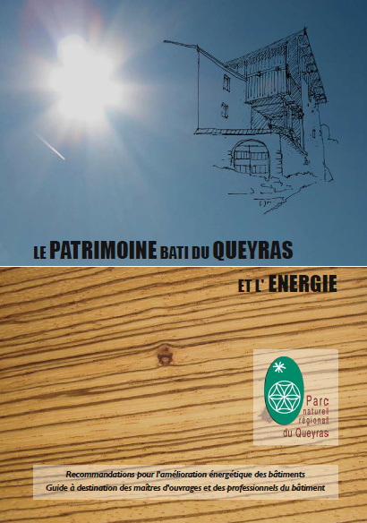
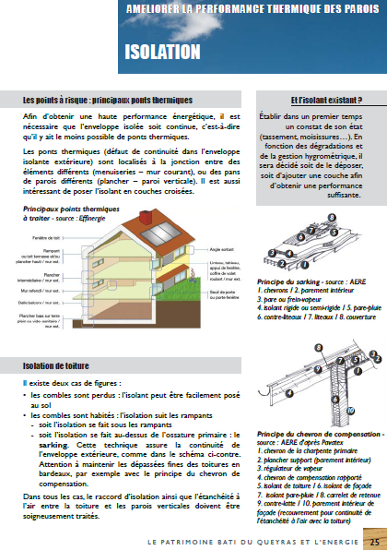
Actions in PNRQ
1/ Guidelines for buildings renovation :
Guide on building renovation according to patrimony stakes
(a lot of ancient buildings have an historical value or are protected)
Building typology has been done
Technical recommendations are identified
Final version published in July
Regional conference on 25th Sept. 2012

Slide 9
Actions in PNRQ
2/ Governance (participative approach on energy planning)
Governance is just starting on energy in the frame of specific actions more than in the Sustainable Energy Action Plan (Plan Climat) :
First meeting on mobility planning programmed the 23th March
Goal : understanding all the stakes of mobility on the territory
2 meetings with touristic actors (hosting) have been held, a third is planned in April
Goal : raising awareness of owners on energy efficiency in their building / presentation of energy audits done on 12 buildings (hotels, B&B, holiday residences) / accompany them in renovation works and financing search

Slide 10
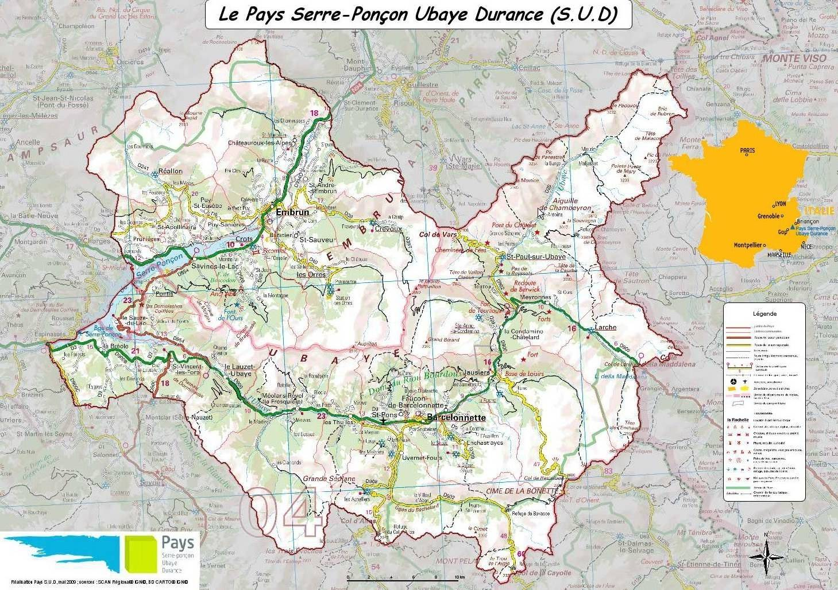
Pays SUD
31 municipality – 20 000 people²

Slide 11
Pays SUD
Energy efficiency for the exploitation of winter sports resorts equipments
Action | Timing
1- Developing and animating working groups | In progress
2- Technical and energy Inventory (including the resource Water) of the equipments of 6 winter ski resorts of the Pays S.U.D | May-Sept 2012
3- Instrumentation and measure of the technical equipments of one or two experimental ski resorts during one season of exploitation | Nov 2012- March 2013
4- Identification of the technical sources of energy savings, disappearance of the electric power and water peak demand | March – Sept 2013
5- Identification of the energy saving potentials in the exploitation, disappearance of the electric power and water peak demand
6- Publishing a guide for the management and the eco-energy technical exploitation of ski resorts equipments | November 2013

Slide 12
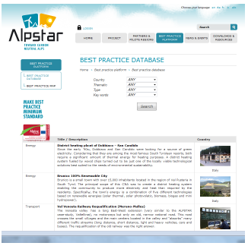
Online best practice data base
http://alpstar-project.eu/best-practice-plateform/best-practice-database/

Slide 13
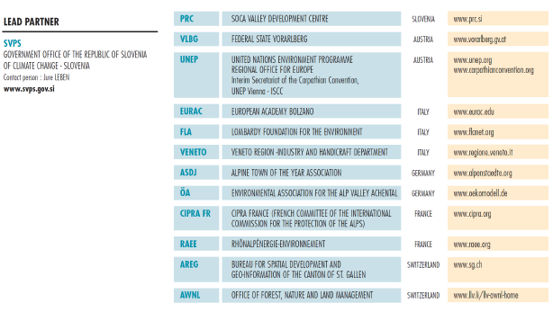
Partnership

