Slide 1
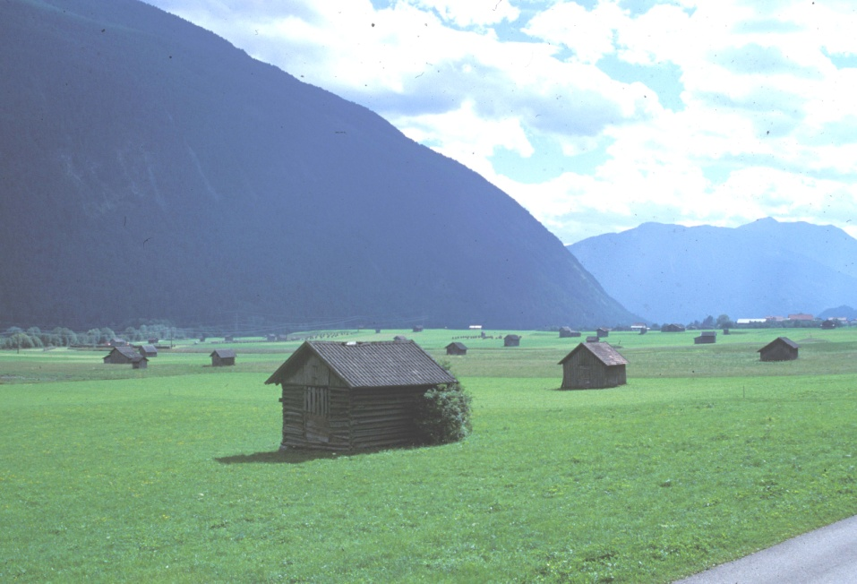
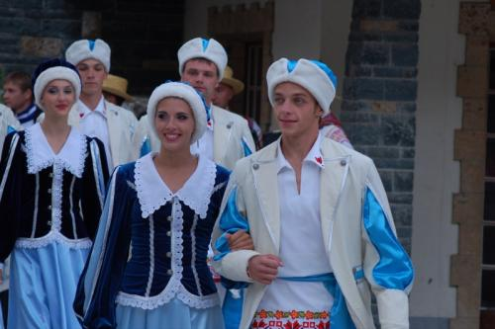
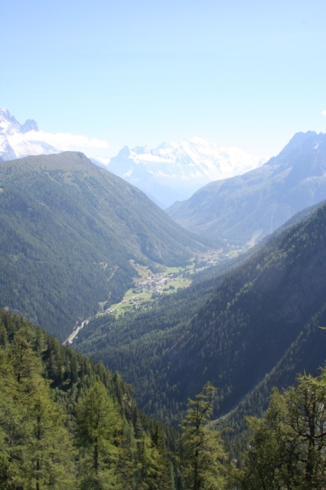
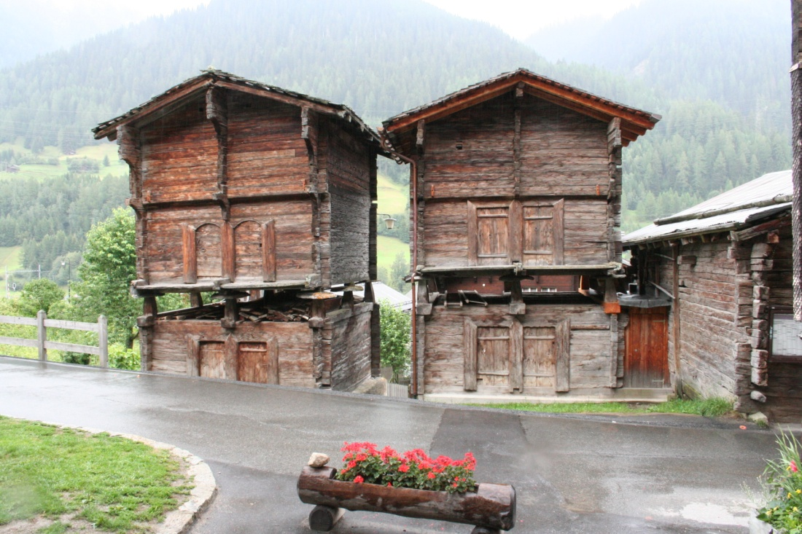
Living in the Alps ?
Bernard Debarbieux - University of Geneva
Session 18: From Old to New - Integrate People, Recycle Knowledge, Create Added Value in Mountain Communities!
Alpweek 2012 - Poschiavo
Notes:
Merci
Connais mal vos communes
Comme bcq, autoroute – St Maurice
Comme quelques uns, habité à Vallorcine et travaillé à Chamonix. Escapades à Finhaut et Salvan
Beaucoup lu sur histoire du Valais, le dvpt économique, etc.
et un peu écrit sur histoire et sociologie des populations alpines, tourisme
Parmi questions sur lesquelles je travaille: que veut dire vivre en montagne aujourd’hui ?
Autrefois, dépendre du milieu naturel pour ses activités et ses revenus: élevage, forêt, tourisme, hydroélectricité
Aujourd’hui, moins vrai
1

Slide 2
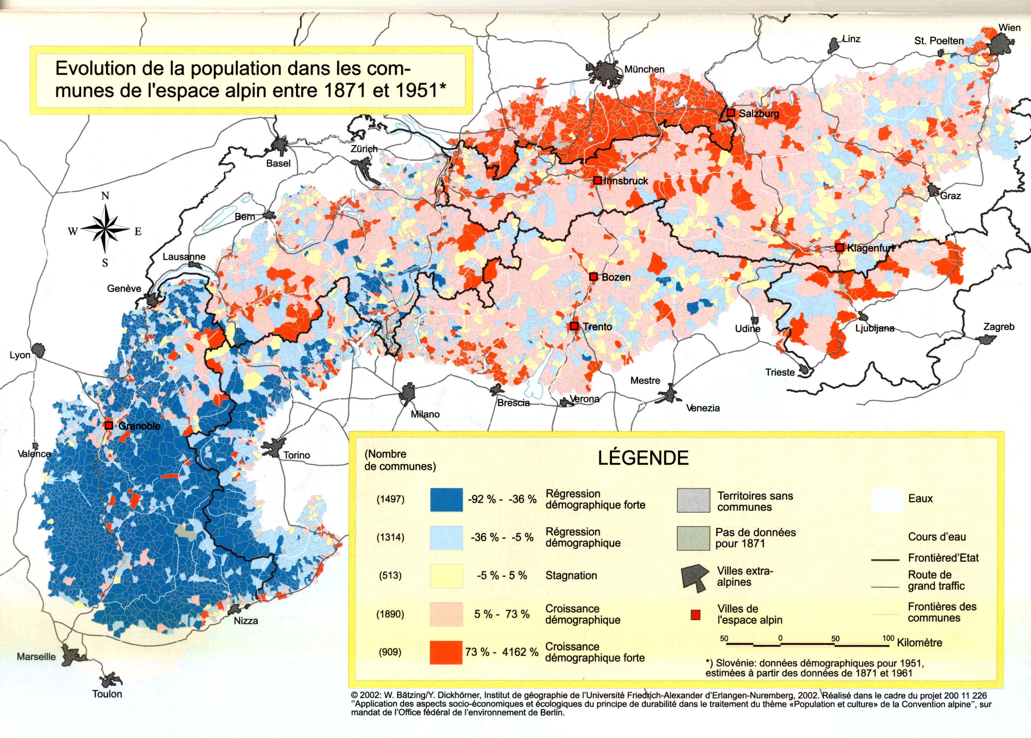
Contrasted demographic trends

Slide 3
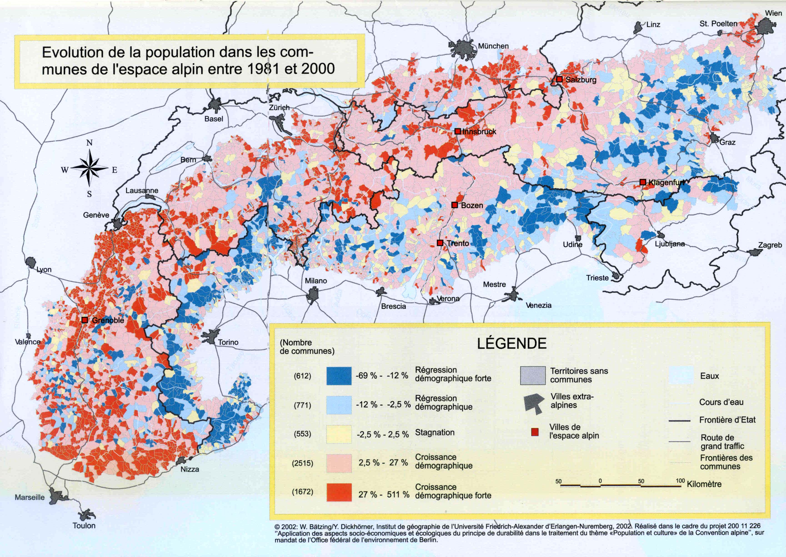
Contrasted demographic trends

Slide 4
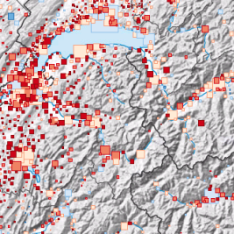
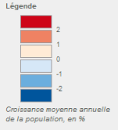
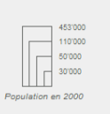
Less and less polarized demographic growth
1940-1950
1990-2000

Slide 5
In-migration in Swiss municipalities Difference between each municipal rate and the average (8,6%)
Jh
Jhv
Mv
Nbv

Slide 6
Out-migration in Swiss municipalities Difference between each municipal rate and the average (7.9%)
Jh
Jhv
Mv
Nbv
Notes:
Turnover
Communes chaudes versus froides

Slide 7
The diversification of inhabitants of alpine municipalities : social features
Local families and new inhabitants
Sedentary people and commuters
Tourists, second home dwellers and permanent inhabitants
= high level of diversification and less en less relevant categories

Slide 8
The diversification of inhabitants of alpine municipalities : social risks
Weakening social links
Neighborhood micro-conflicts
Disagreements on public management models: how to choose between a choral and a hunters association ? Between cross-country tracks and intense forestry valorization ?
Etc.

Slide 9
How to renew local societies ?
Local societies are no more an evidence. They have to be deliberately shaped and reshaped.
Working on images and narratives
Working of local trade and products
Working on local common values
= Reinventing specificity and singularity

Slide 10
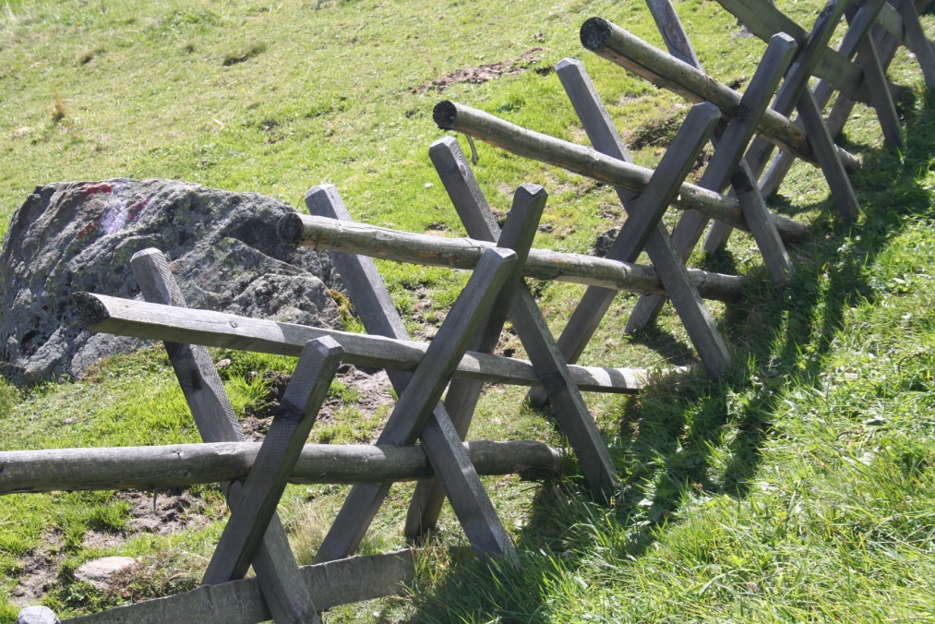
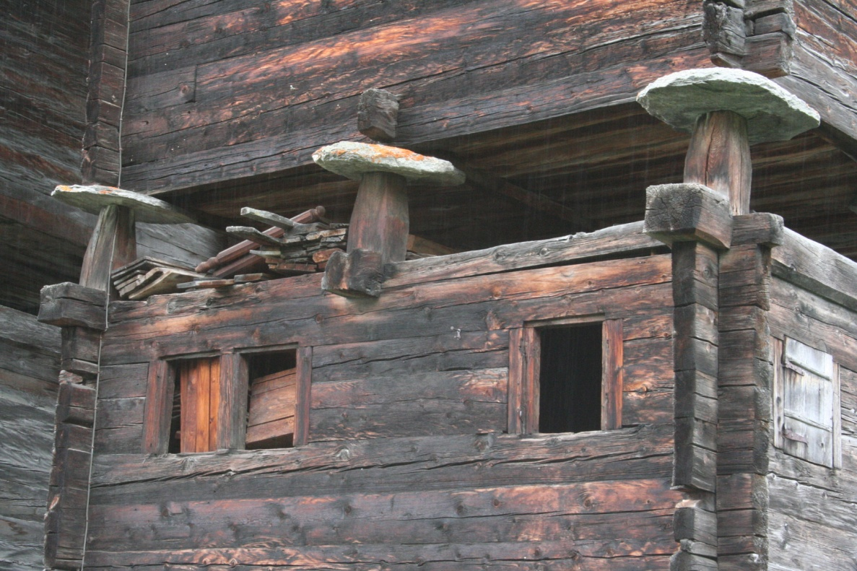
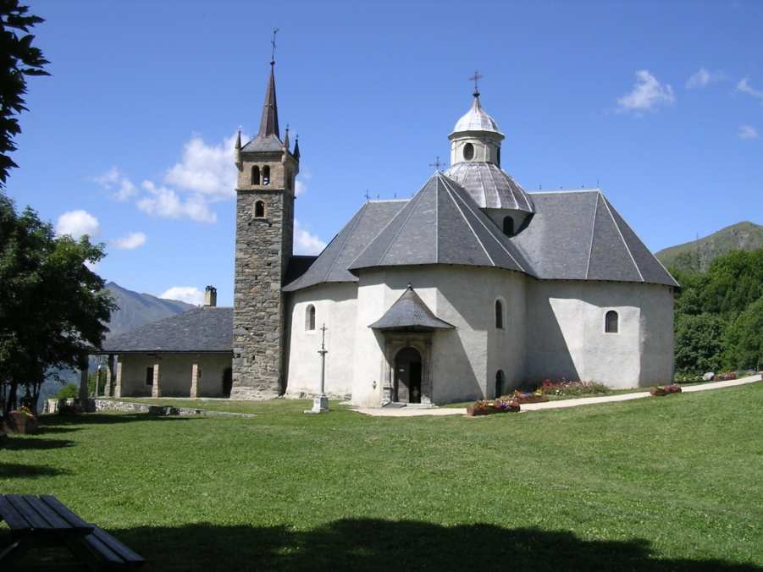
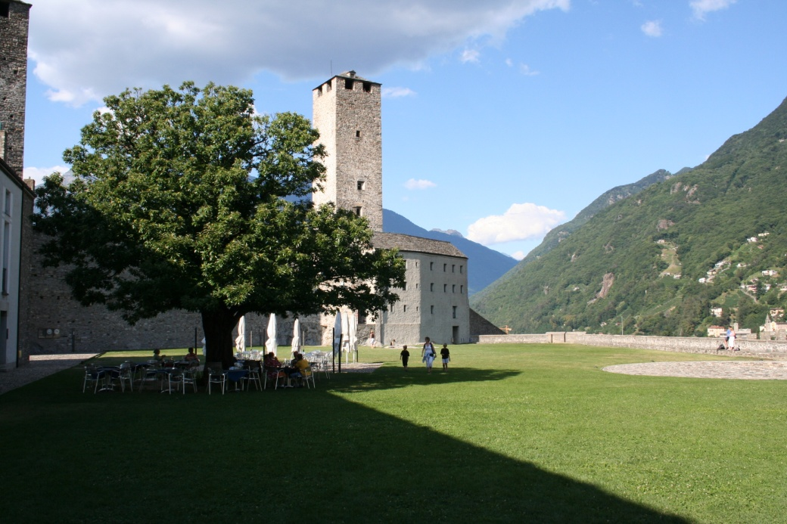
1. Working on images and narratives

Slide 11
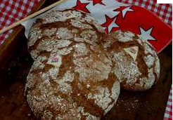
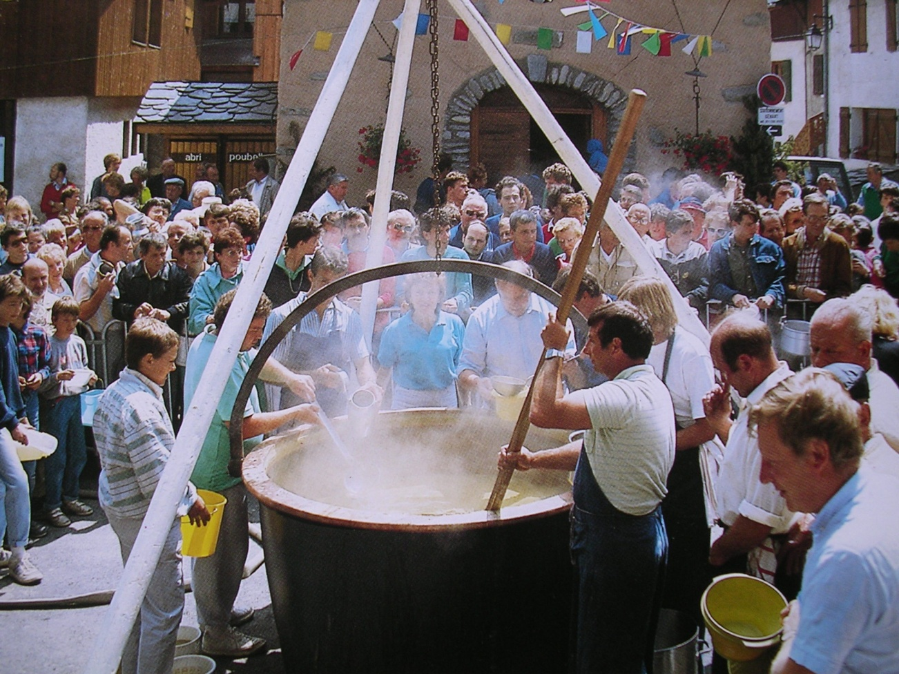
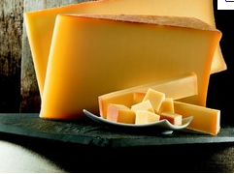
2. Working of local trade and products
Branding of local products

Slide 12
2. Working of local trade and products
Regiogeld

Slide 13
3. Working on local common values
Chamonix, 2006

Slide 15
Living in the Alps today Flows and roots
Flows of people, goods, money, images = a threat for social links and territorial cohesion ?
Local roots : weakness and strenght = alpines territories at work

Slide 16
Some references
Bernard DEBARBIEUX et Martin CAMENISCH, 2011, « Intra-municipal migrations in Switzerland : a « mountain-effect », Journal of alpine resaerch [on line], 99-1
http://rga.revues.org/1360 ; DOI : 10.4000/rga.1360
Bernard DEBARBIEUX, Cristina del BIAGGIO et Mathieu PETITE, 2008, “Spatialités et territorialités du tourisme. Dialectique du flux et de l’ancrage dans les Alpes », Civilisations, LVII, 1-2, 75-89
Bernard DEBARBIEUX et Gilles RUDAZ, 2010, Les faiseurs de montagne: imaginaires politiques et territorialités (XVIIIe-XXIe siècle), Paris, CNRS-Editions.

