Slide 1
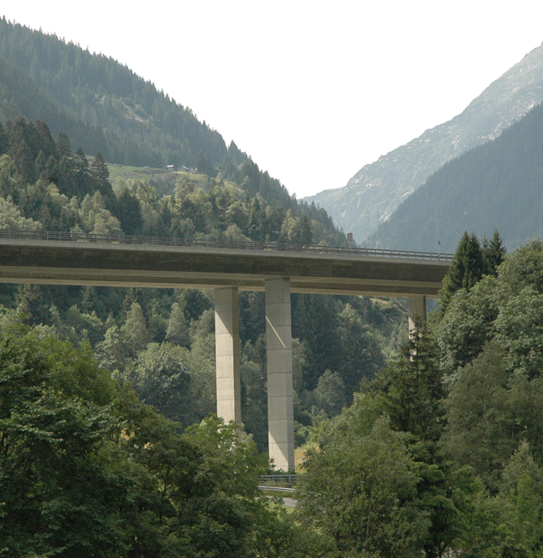
AMT FÜR UMWELTSCHUTZ
ABTEILUNG
IMMISSIONSSCHUTZ
Transalpine traffic: New Solutions to Old Challenges?
AlpWeek
September 6, 2012
Niklas Joos-Widmer

Slide 2
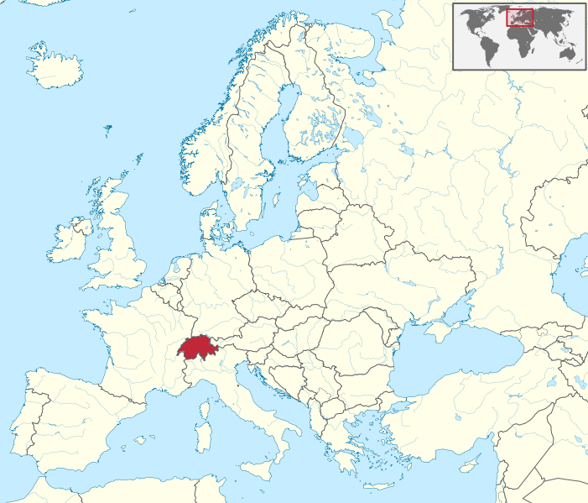
Switzerland
Location
Quelle: Wikimedia Commons, Urheber: TUBS
http://de.wikipedia.org/w/index.php?title=Datei:Switzerland_in_Europe.svg&filetimestamp=20110317171007

Slide 3
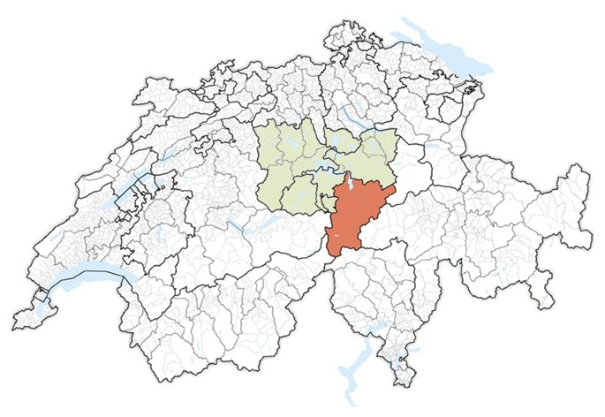
Kanton Uri in Central Switzerland
Location
Quelle: Wikipedia, Urheber: Tschubby, eigene Bearbeitung
http://de.wikipedia.org/w/index.php?title=Datei:Karte_Lage_Kanton_Uri_2012.2.png&filetimestamp=20120311090221

Slide 4
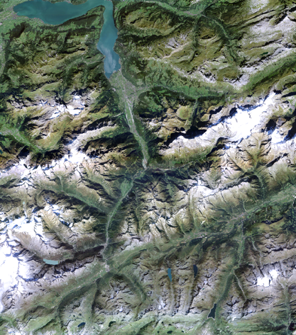
Uri in numbers
Uri
1’077 km2 area
35’000 inhabitants
9.4 % foreigners
13’400 jobs (in fulltimejobs-equivalents)
1.4 % unemployment
3’400 students
17’000 appartements
87 hotels
9’700 cows, 8’800 sheep
Source: Uri in Zahlen 2011 / 2012
Quelle: Lisag AG

Slide 5
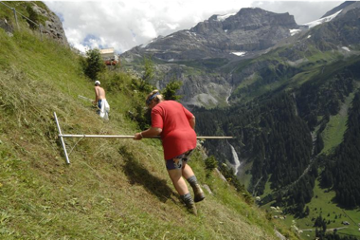
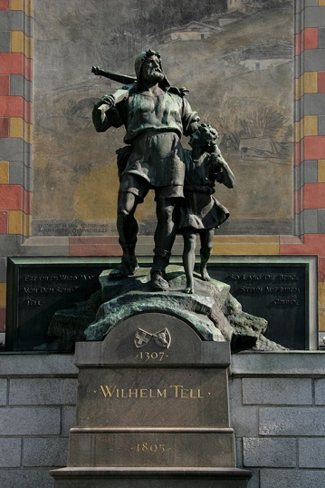
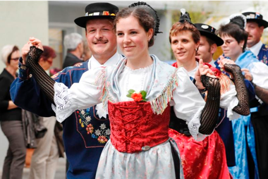
Traditional Uri
Uri
Quelle: Korporation Uri
Quelle: Korporation Uri
Quelle: Roland Zumbühl

Slide 6
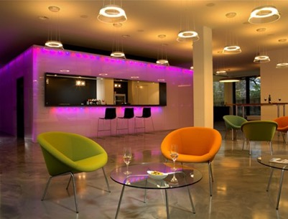
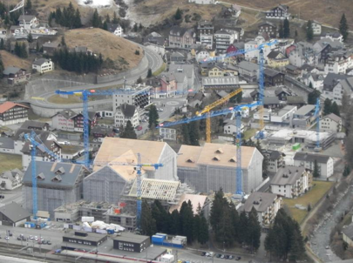
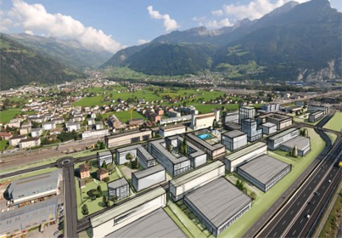
Modern Uri
Uri
Quelle: Seescjüttung
Quelle: Q4 – Altdorf Ost
Quelle: Andermatt Swiss Alps ASA
Quelle: Kanto Uri

Slide 7
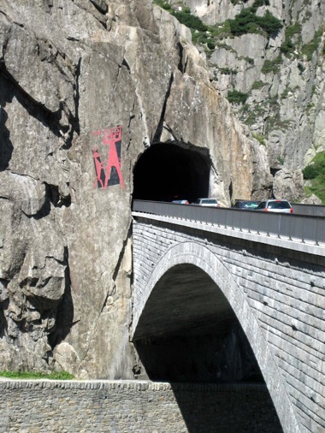
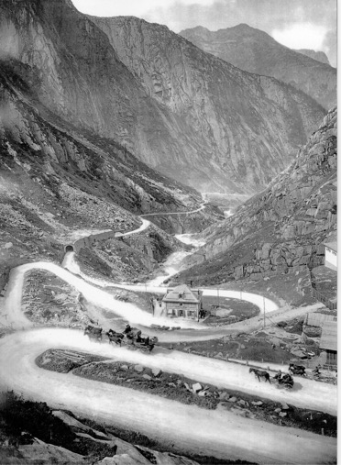
Transit region
Uri
Quelle: Adrian Michael
Quelle: unbekannt
Notes:
Schöllenen um 1920

Slide 8
Railway, Motorway
Uri
1882
1980

Slide 9
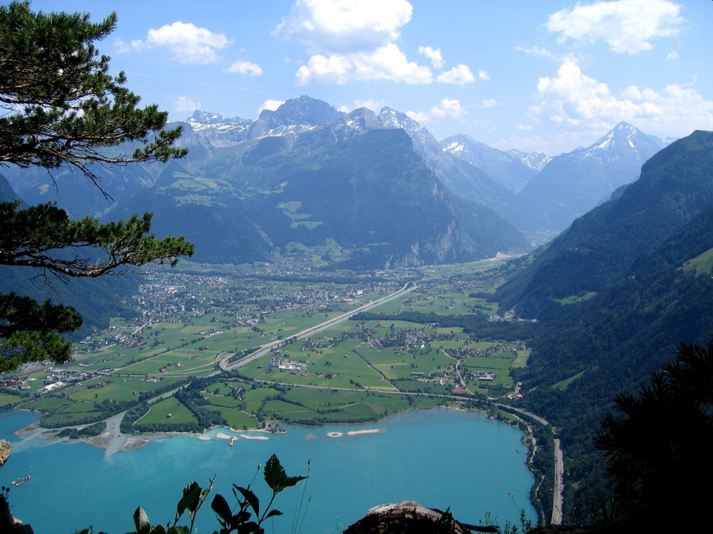

Slide 10
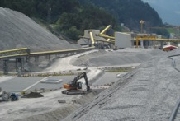
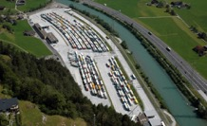
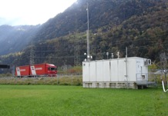
Alpine Initiative – Modal Shift Policy
Policy Switzerland
1994 the Swiss people voted for the Alpine Initiative which demands protection of the Alpine Space and modal shift from road to rail
Since then Switzerland took measures such as
Performance-related Heavy Vehicle Fee (HVF)
Construction of a new railway-infrastructure NEAT
Heavy Duty Vehicles Control Centers
Financial support for rail-transport
Observation of transport development and environmental impacts
Quelle: Urner Kantonspolizei

Slide 11
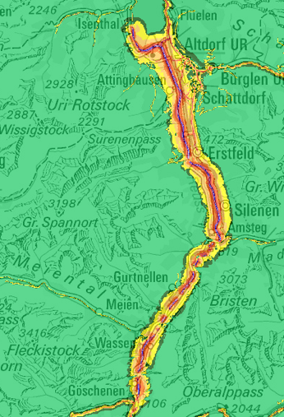
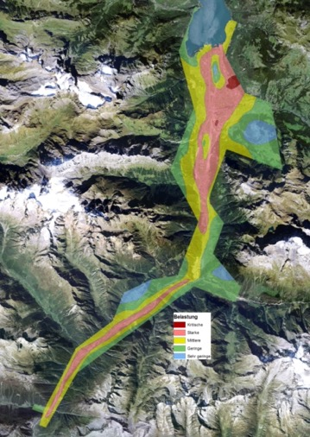
Immissions
MfM-U
Noise
Airquality
Quelle: BAFU

Slide 12
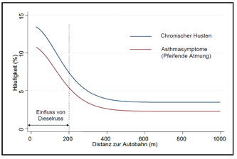
Health Impact
MfM-U
Quelle: Gesundheitsstudie MfM-U, THP Basel
Quelle: Kanton Uri

Slide 13
Alpine Effect
MfM-U
Alpine Valley
Flat land

Slide 14
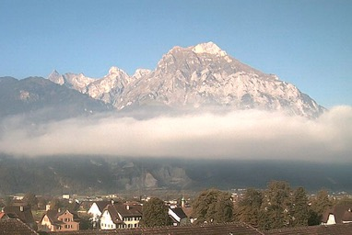
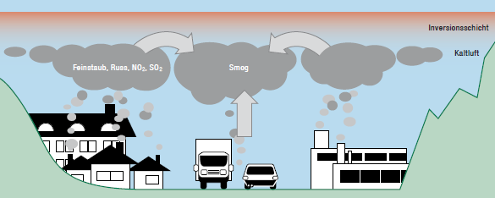
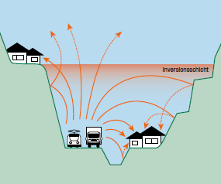
Reasons
MfM-U
Inversions
Slope
Exposition
Sensible area
Quelle: InNet Monitoring AG
Quelle: BAFU
Quelle: BAFU

Slide 15
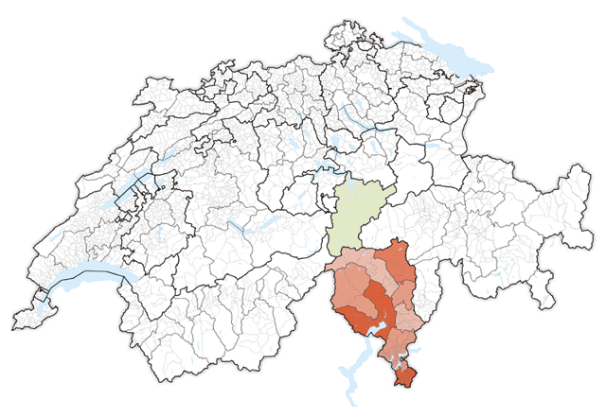
Copy-paste to Ticino
MfM-U
Quelle: Wikipedia, Urheber: Tschubby, eigene Bearbeitung
http://upload.wikimedia.org/wikipedia/commons/6/63/Karte_Lage_Kanton_Tessin_2012.2.png
Notes:
Quelle: Wikipedia, Urheber: Tschubby
http://upload.wikimedia.org/wikipedia/commons/6/63/Karte_Lage_Kanton_Tessin_2012.2.png

Slide 16
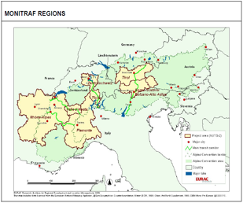
What about the other transit Regions?
MONITRAF
Corridors:
Fréjus
Mont-Blanc
Gotthard
Brenner
Duration: 2005 – 2008
Partners: 9
Outcome:
Transalpine Traffic forms a corresponding system → common approach needed
Political resolution
further development of a common monitoring system
exchange on regional best practices
development of a common modal shift policy
further analysis of common traffic management instruments
Quelle: Monitraf

Slide 17
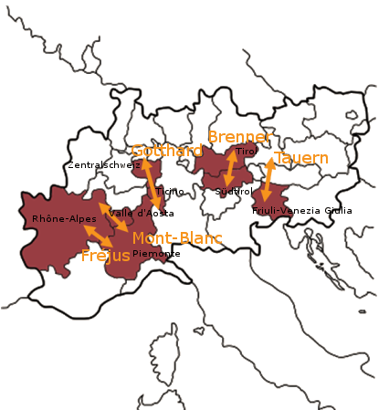
Follow-Up Project
iMONITRAF!
Corridors:
Fréjus
Mont-Blanc
Gotthard
Brenner
Tarvisio
Duration: 2009 – 2012
Partners: 10

Slide 18
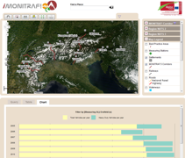
Outcome of iMONITRAF!
Monitoring
Monitoring
Modelling and examination of noise immissions, airquality and traffic
Evaluation of indicators
Development of a WebGIS-System on indicators
Guidelines on the measurement of noise immissions

Slide 19
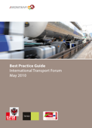
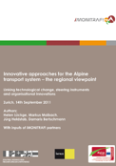
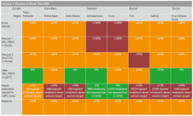
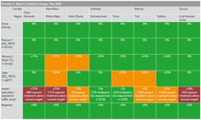
Outcome of iMONITRAF!
iMONITRAF!
Measures
Best Practice Guide
Innovative Approaches
Scenario-Analysis
Business as usual
Alpine Crossing Exchange

Slide 20
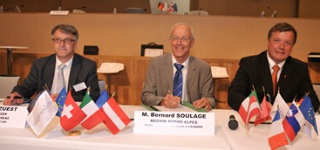
Political outcome (1/2)
iMONITRAF!
Strategy & Resolution with the following contents
Common targets
2020: meet environmental targets and reduce CO₂-Emissions by 20 %
longterm: make full use of the railway-capacities
➔ translated into corridor-specific targets
Introduce the best technology for road-traffic
Make the rail more attractive and efficient

Slide 21
Political outcome (2/2)
iMONITRAF!
Harmonisation best-practice measures
Passenger transport:
better access to information services and multimodal pricing
the implementation of lower speed limits
Road freight transport:
bans on the most polluting heavy goods vehicles
bans on night driving
sector-based bans
Internalise the external cost of road traffic
Introduce a cap-and-trade-system such as the Alpine Crossing Exchange
Continue the cooperation

Slide 22
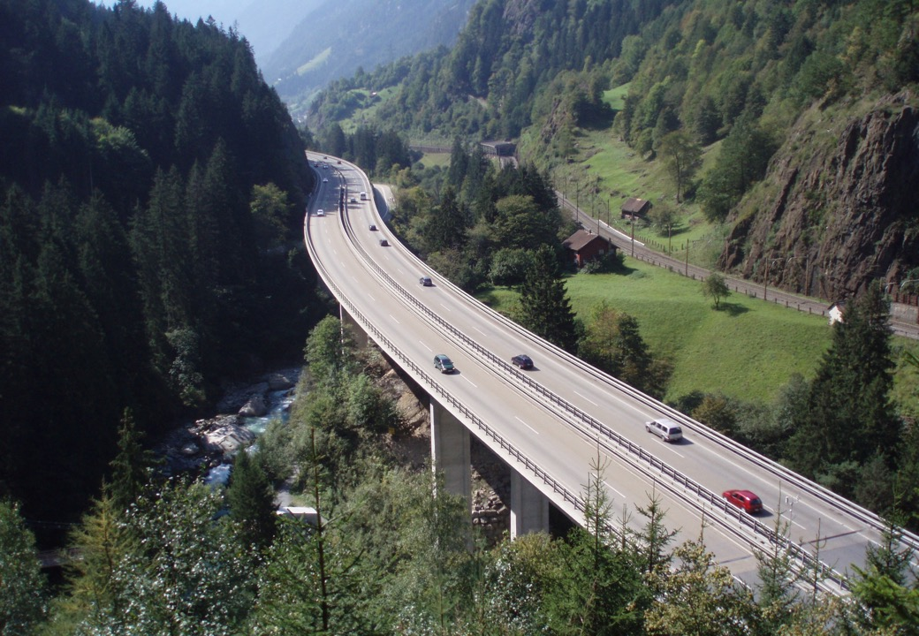
Thank you for your attention!
Further information available at
www.imonitraf.org
Quelle: A. Imhof

