Slide 1
Regional managers – architects of the regions Experiences from the New Regional Policy (NRP) in Switzerland
September 7th 2012 11.00−12.30 Valposchiavo
Sebastian Bellwald, Director regiosuisse
Owner Planval AG Brig/Bern

Slide 2
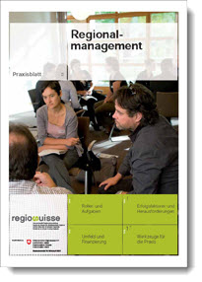
The following slides are extracts from the publication „Praxisblatt Regionalmanagement“
Contents „Praxisblatt Regionalmanagement“:
Background
Regional management and regional development
Roles and tasks of regional management
Environment and funding of regional management
Success factors and challenges
Practice tools
(published in 2011 in German, French & Italian)
.

Slide 3
What does regional management (RM) mean?
An organisation that steers (or manages) sustainable regional development by involving multiple stakeholders
Ideally on the basis of a commonly elaborated regional development strategy
RM is an essential component for the implementation of the NRP. Vice versa the NRP is only one of many stimulus programmes that RM has at its disposal.
Notes:
http://www.idee-seetal.ch/wv_ideeseetal/w_ideeseetal/cgi-bin/cc/dateien/grundlagendokumente/bundesvorgaben%20professionelles%20regionalmanagement.pdf

Slide 4
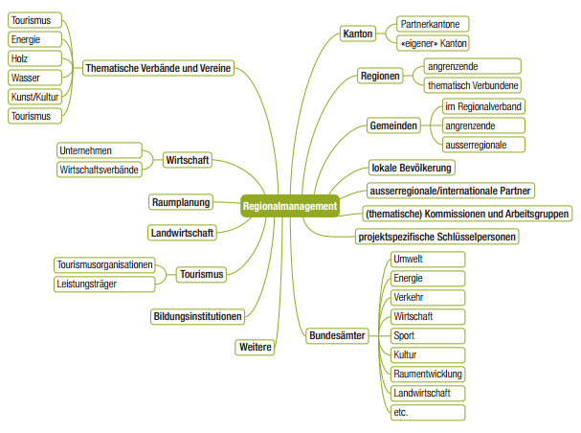
Roles and tasks of RM
Representation of the region
Identification of regional potential
Motivation and support of regional stakeholders in initiating, planning and implementing projects («Midwife», «Facilitator», «Instigator»)
RM is not be mistaken with a new territorial level between the state, canton and municipality. Regional governance rather than regional government.
Notes:
http://www.idee-seetal.ch/wv_ideeseetal/w_ideeseetal/cgi-bin/cc/dateien/grundlagendokumente/bundesvorgaben%20professionelles%20regionalmanagement.pdf

Slide 5
Action arena „regional development“: functional spaces
Cultural
Societal ≠ municipial, district or cantonal border
Economic
Transterritorial cooperation: «Even if regional management is usually embedded into regional structures, it does not limit its actions to the region. Depending on the project or undertaking the action range changes, as well as the actor constellation.»
(= variable geometry: territorial reference varies with the function; a region transcends its borders.)
Praxisblatt RM

Slide 6
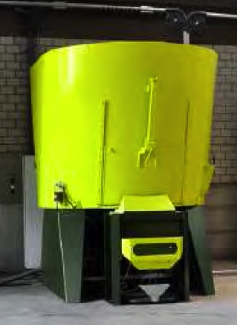
Project example: Integrated use of biomass
Project idea
R&D for design of prototype to utilise biomass (integration of existing machines)
Output of the machine: pellets for heating/ power generation or as fodder
After completion of NRP funded phase: optimisation of machine to production, then sale of the machine to farmers as franchise partners ➔ Own use of the pellets or sale to public authorities
Quelle: Bioburn AG

Slide 7
Eight challenges – and how they can be met
Identification of project initiators > Networking and communication
Communication between NRP and project initiators > RM as mediator/interpreter
Marketability of projects > Professionalisation with help of business model design (ex.)
Commercial viability of projects > Long-term project management
Interpretation of NRP terms for funding > Assessment of projects – flexible interpretation of terms
General (legal) conditions constraining innovation
> Linking-up with responsible departments and perseverance
Delays in project schedule > Flexible programme duration
Project development after NRP funding > Wholistic support by RM

Slide 8
Key tasks and possible functions of RM
Development strategies
Networking
Communication
Mediating between different interest groups
Regional identity
Consulting
Evaluation of projects
Knowledge transfer
Project management support
Projects Processes

Slide 9
Regional management between the conflicting fields of routine and innovation
Flexibility and capitalise on opportunities
Security
RM
Readiness to
assume risk
Fault tolerance
Consistency
Routine
Consolidation
Innovation
Output
orientation
Process orientation
Professionalisation
etc.
Realise chances
Regional performance
Notes:
Chancen zu erkennen
Prozesse zuzulassen
Auf Opportunitäten zu reagieren
Flexibel zu sein
Risiken einzugehen
→ Voraussetzung: Innovationsfähigkeit bedingt Regionskompetenz (fundierte Kenntnisse der regionalen Akteure, der Stärken, Zusammenhänge und Besonderheiten). Nichteinheimische können dieses Wissen anwenden.
→ Ein weiterer begünstigender Faktor für die Entstehung von neuen Ideen und Innovationen ist horizontale Vernetzung (nicht hierarchische Vernetzung).

Slide 10
Legal forms and funding
Legal basis: service level agreement between canton and regional development agency (i.e. RM)
Forms:
Mandate to municipalities association – Mandate to a company
Integration into cantonal administration – Mandate to regional conference
Funding of RM:
Contributions from municipalities or organisations being part of the patronage
Basic or full financing from the canton
Project based funding
Income from services provided by RM
Sponsoring

Slide 11
Profile of qualification regional management
Qualifications profile RM
Professional competence
Regional competence
Social and networking competence
Project competence
Process competence
Crossborder management competence
Personal competence
High requirements
Possibly involvement of third parties
Specialisation possible with RM team
Notes:
Hohe Anforderungen, evtl Einbezug Dritter oder Einsatz eines RM-Teams -> Spezialisierung möglich

Slide 12
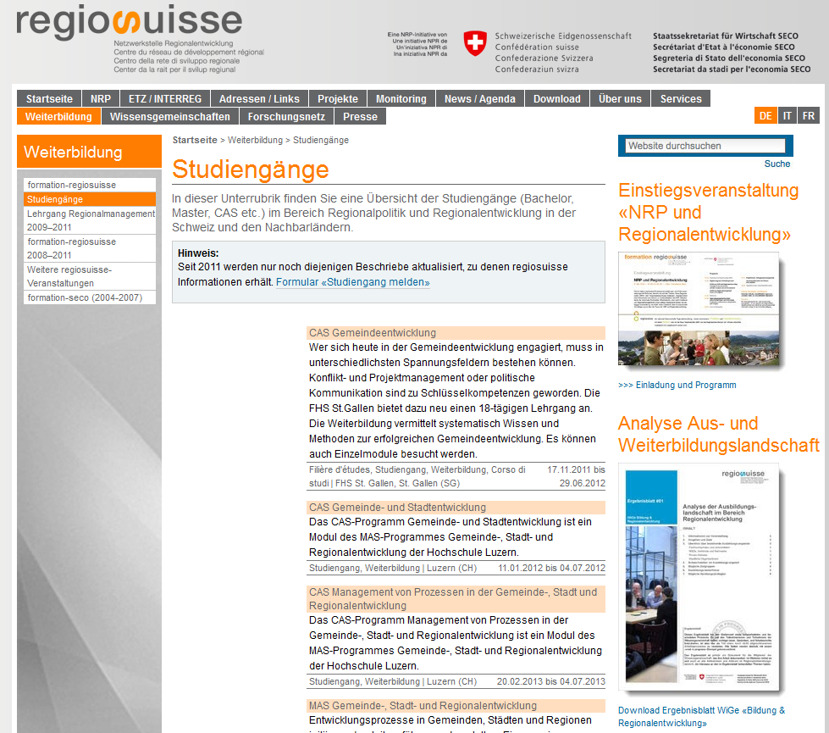
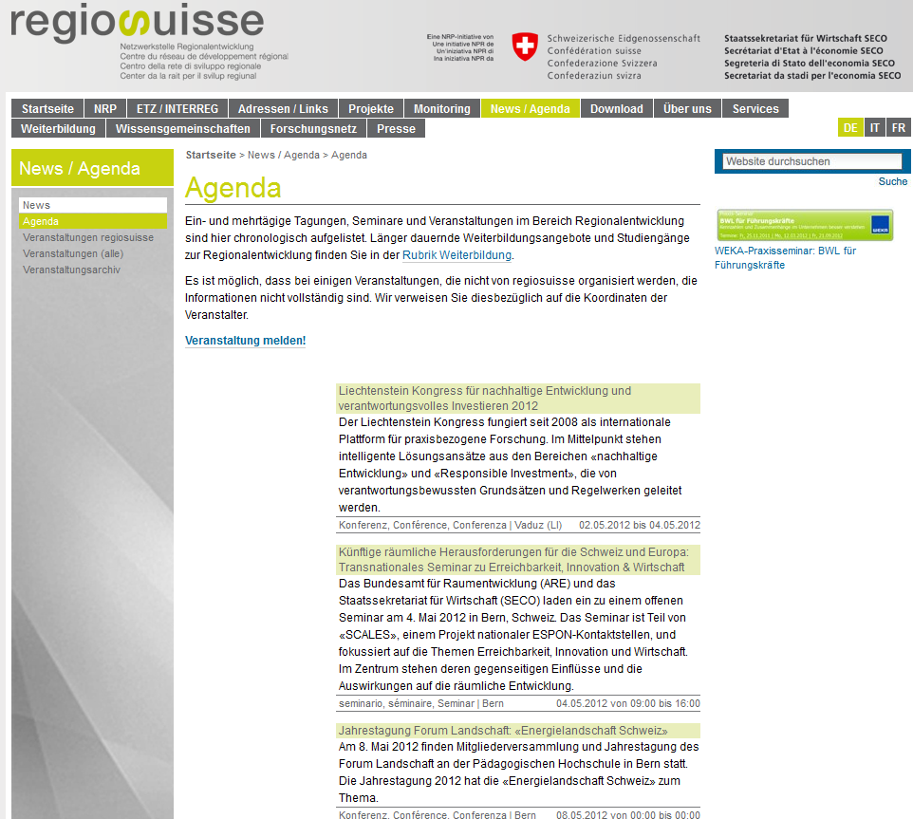
Information about offers of continued education for regional managers
Study programmes:
Agenda:
Events of extraregional interest in the area of regional development in Switzerland and neighbouring countries
Notes:
Quelle: PP regiosuisse D euregia 2010 Johannes Heeb Schlussversion 261010

Slide 13
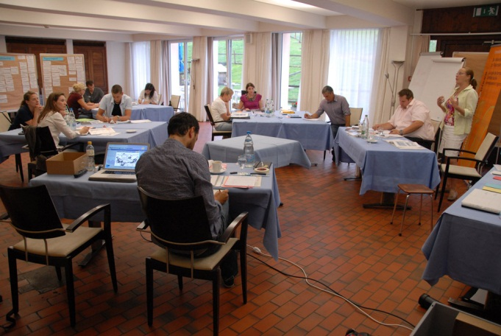
Information: formation-regiosuisse RM course
RM courses for the continued study of relevant topics, methods etc. of RM
Sign up for individual courses or the entire programme (5 ECTS)*
Coming-up courses:
12.–15. November 2012 Impact oriented regional development (incl. topic of gender)
28.– 30. January 2013 Regional network management & communication
13.–15. May 2013 Regional entrepreneurship and regional economics
16.–19. September 2013 Special topic or process competence
Registration and additional information in German, French, Italian:
www.regiosuisse.ch/formation/formation-regiosuisse
www.regiosuisse.ch/formazione/formation-regiosuisse
www.regiosuisse.ch/weiterbildung/formation-regiosuisse

Slide 14
In summary:
RM are active in many parts of Switzerland to support stakeholders in developing and implementing their projects
RM are vitally important for the development of a region
Make use of RM for your projects and for exchange of experiences
On behalf of SECO, regiosuisse supports RM and other regional development stakeholders with knowledge platforms, events, continued education...
Notes:
Quelle: PP regiosuisse D euregia 2010 Johannes Heeb Schlussversion 261010

Slide 15
Thank you for your attention!

Slide 16
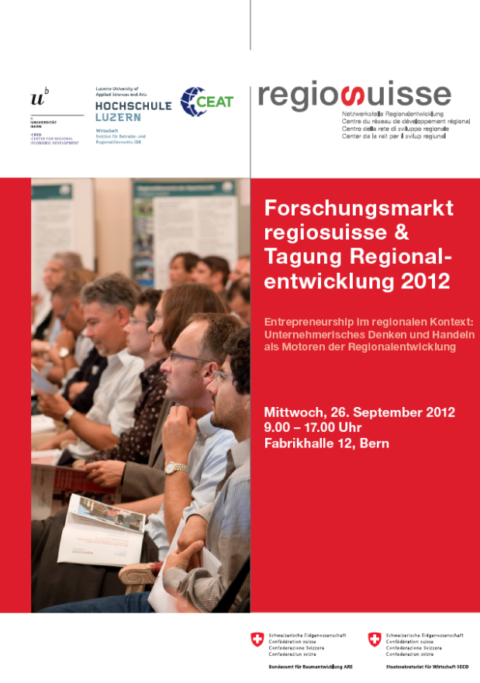
Thank you for your attention!
Good to Know:
Research Marked regiosuisse & Conference Regional Development
Berne
September 26 2012

