Slide 1
Regional Management in practice Success Factors François Parvex, Alpine Week, Poschiavo, September 7th 2012
Notes:
Sujet qui ouvre des nouvelles pistes pour la définition de politiques de développement : du terrain à la planète

Slide 2
Networking
The force is in the group.
Humanity left the evolution process …
the only way for it to progress is by networking the brains. (Albert Jacquard)

Slide 3
Anticipation
Create an observation system, a dashboard, which measures relevant evolution inside and outside the region.

Slide 4
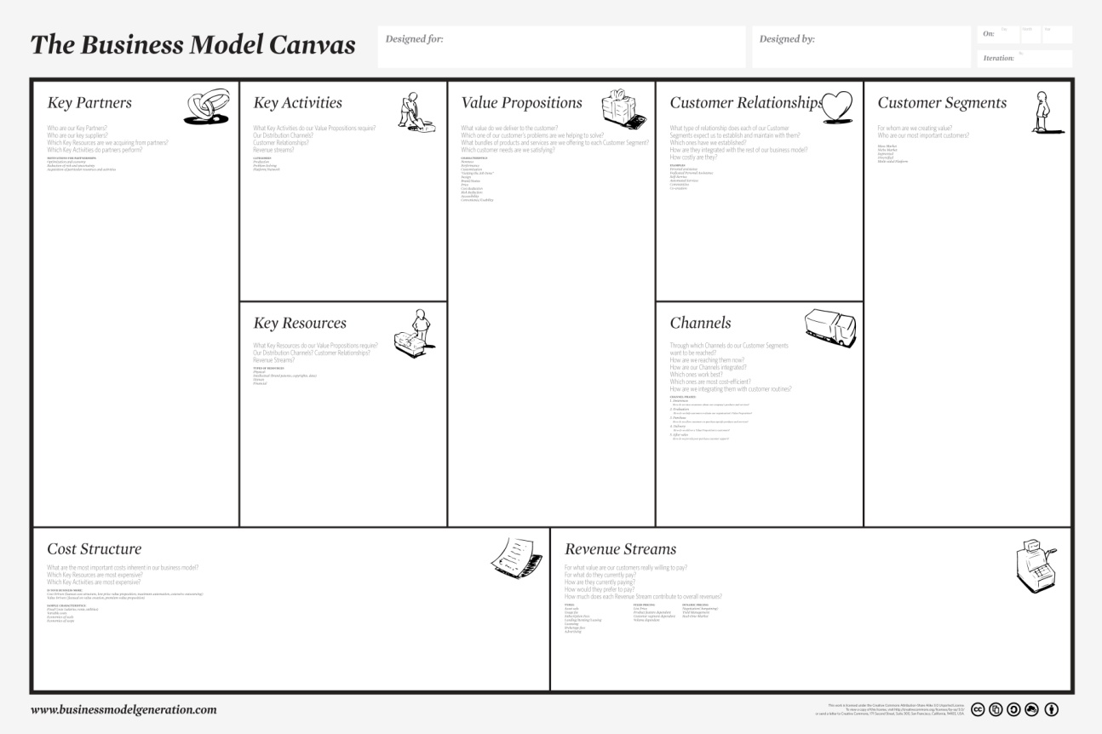
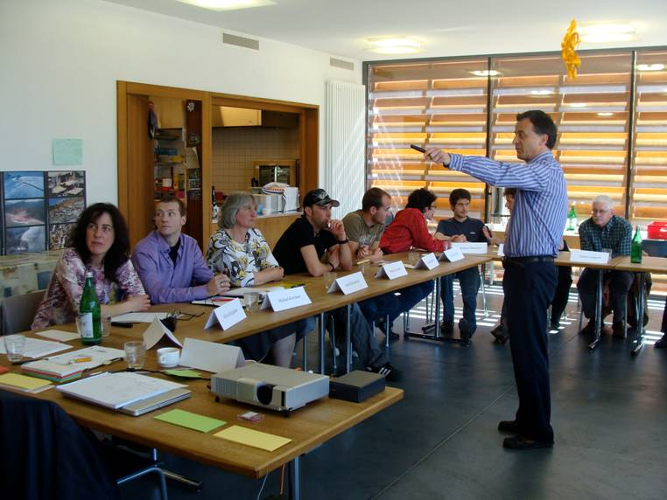
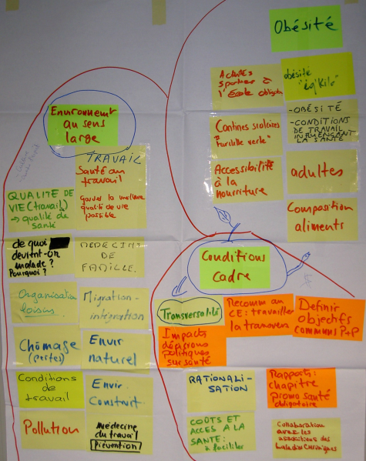
Knowledge of methods and models
Use existing methods and models, develop you own ones.

Slide 5
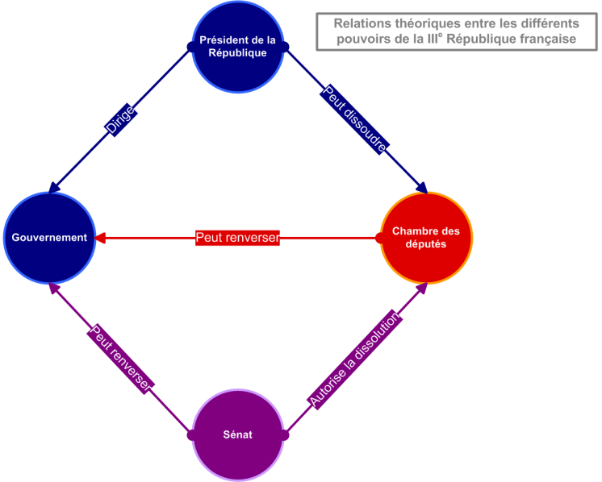
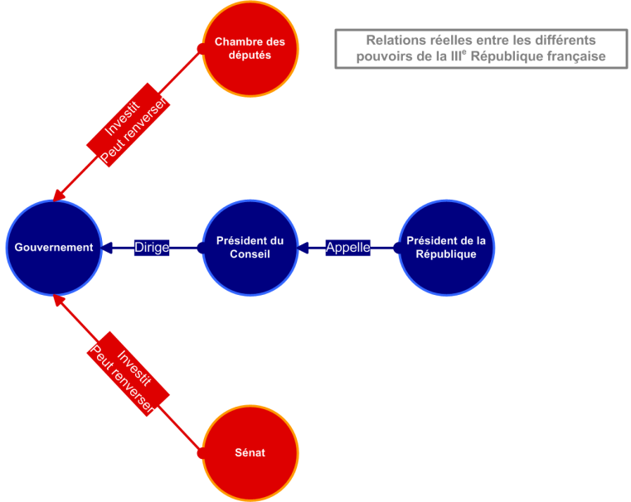
Knowledge of powers
Theoretical powers Real powers
Identify the real powerful people.

Slide 6
Respect of perceptions
One must be aware of what others bring. The more they think differently the richer is their contribution. (Albert Jacquard)
They are all right … and they are all wrong !

Slide 7
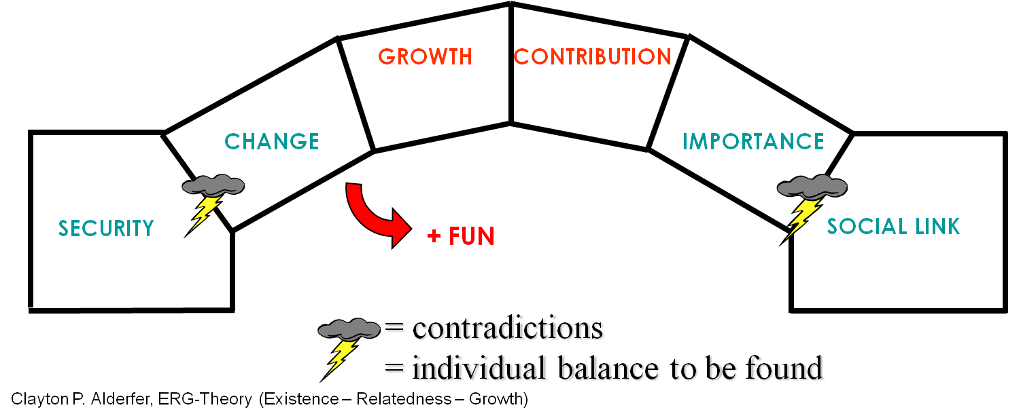
Boost motivation
6 needs of human beings:
2 essential needs
4 basic needs
Motivation is there or not. You can only contribute to maintain and boost it.

Slide 8
4 KSF for cooperation
OPENESS
POSITIVE
PREVIOUS EXPERIENCE
RICHNESS OF
INTERACTIONS
Discuss, there will always be something remaining.
TRUST

Slide 9
Learning Region Process
The Success Factors of Regional Management can be summarized in one word: curiosity.

Slide 10
www.serec.ch
SEREC François Parvex
Via Bicentenario 3
CH – 6807 Taverne
parvex@serec.ch

